Slide 1
HOW TO MAKE PAYMENT BY ROVOLUT
(if automatic payment is not working)
MRU Student house Administration

Slide 2
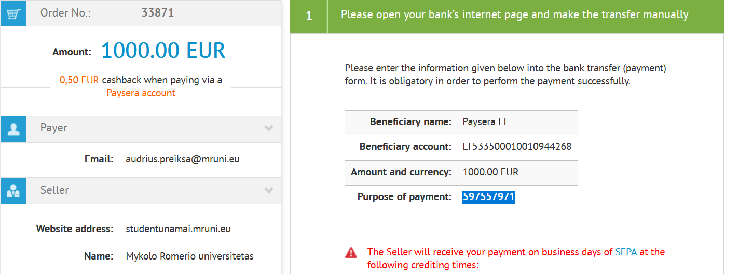
MAKING FIRST MANUAL TRANSFER
When you reach payment part in MRU Student house reservation/ payment system and choose Revolut option you will see this window:
MRU Student house Administration

Slide 3
MAKING FIRST MANUAL TRANSFER
PLEASE NOTE THAT BENEFICIARY IS NOT:
“MYKOLAS ROMERIS UNIVERSITY”
BUT A MEDIATOR BANK- Paysera LT
When you reach payment part in MRU Student house reservation/ payment system and choose Revolut option you will see this window:
MRU Student house Administration

Slide 4
MAKING FIRST MANUAL TRANSFER
When you reach payment part in MRU Student house reservation/ payment system and choose Revolut option you will see this window:
IN YOUR PAYMENT YOU MUST DELETE: “Sent from Revolut”
Then enter your Purpose of payment instead
IMPORTANT: each payment has a different number, check here before making your payment.
MRU Student house Administration

Slide 5
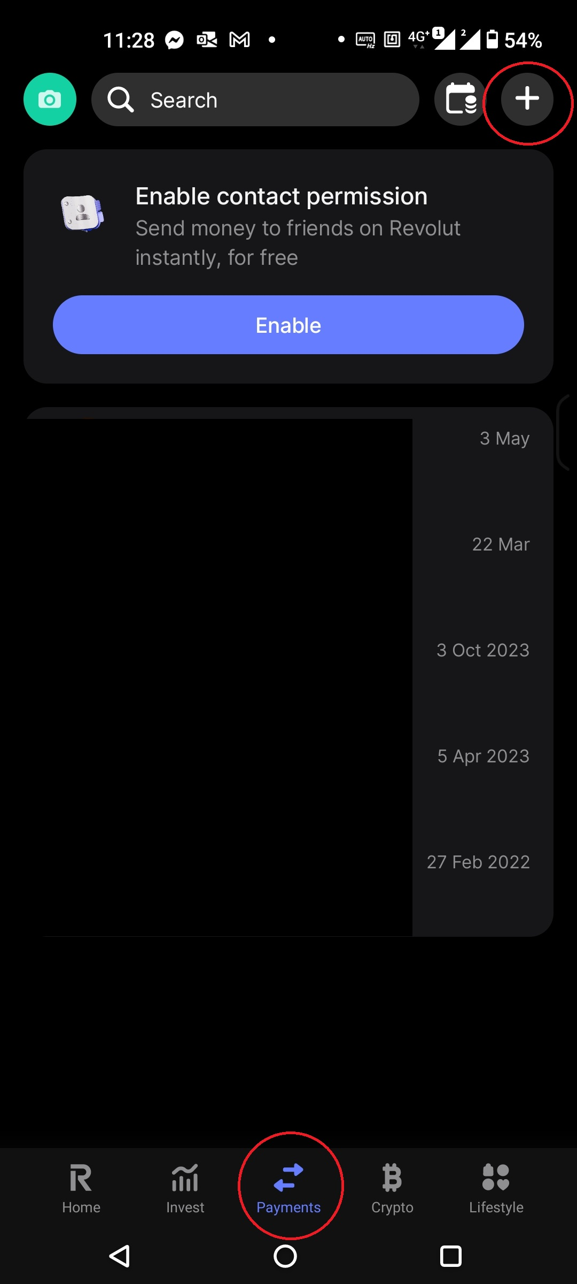
OPEN REVOLUT app IN YOUR PHONE
MRU Student house Administration

Slide 6
OPEN REVOLUT app IN YOUR PHONE
Click on “Payments”
MRU Student house Administration

Slide 7
OPEN REVOLUT app IN YOUR PHONE
Click on “+”
To add “New transfer”
MRU Student house Administration

Slide 8
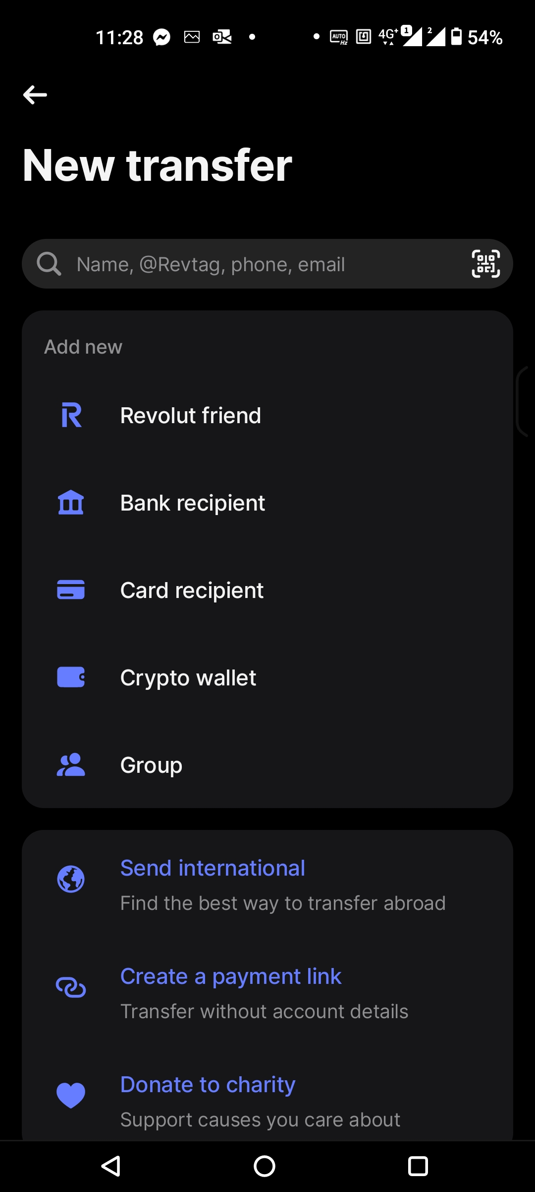
IN New Transfer
Choose “Bank recipient”
MRU Student house Administration

Slide 9
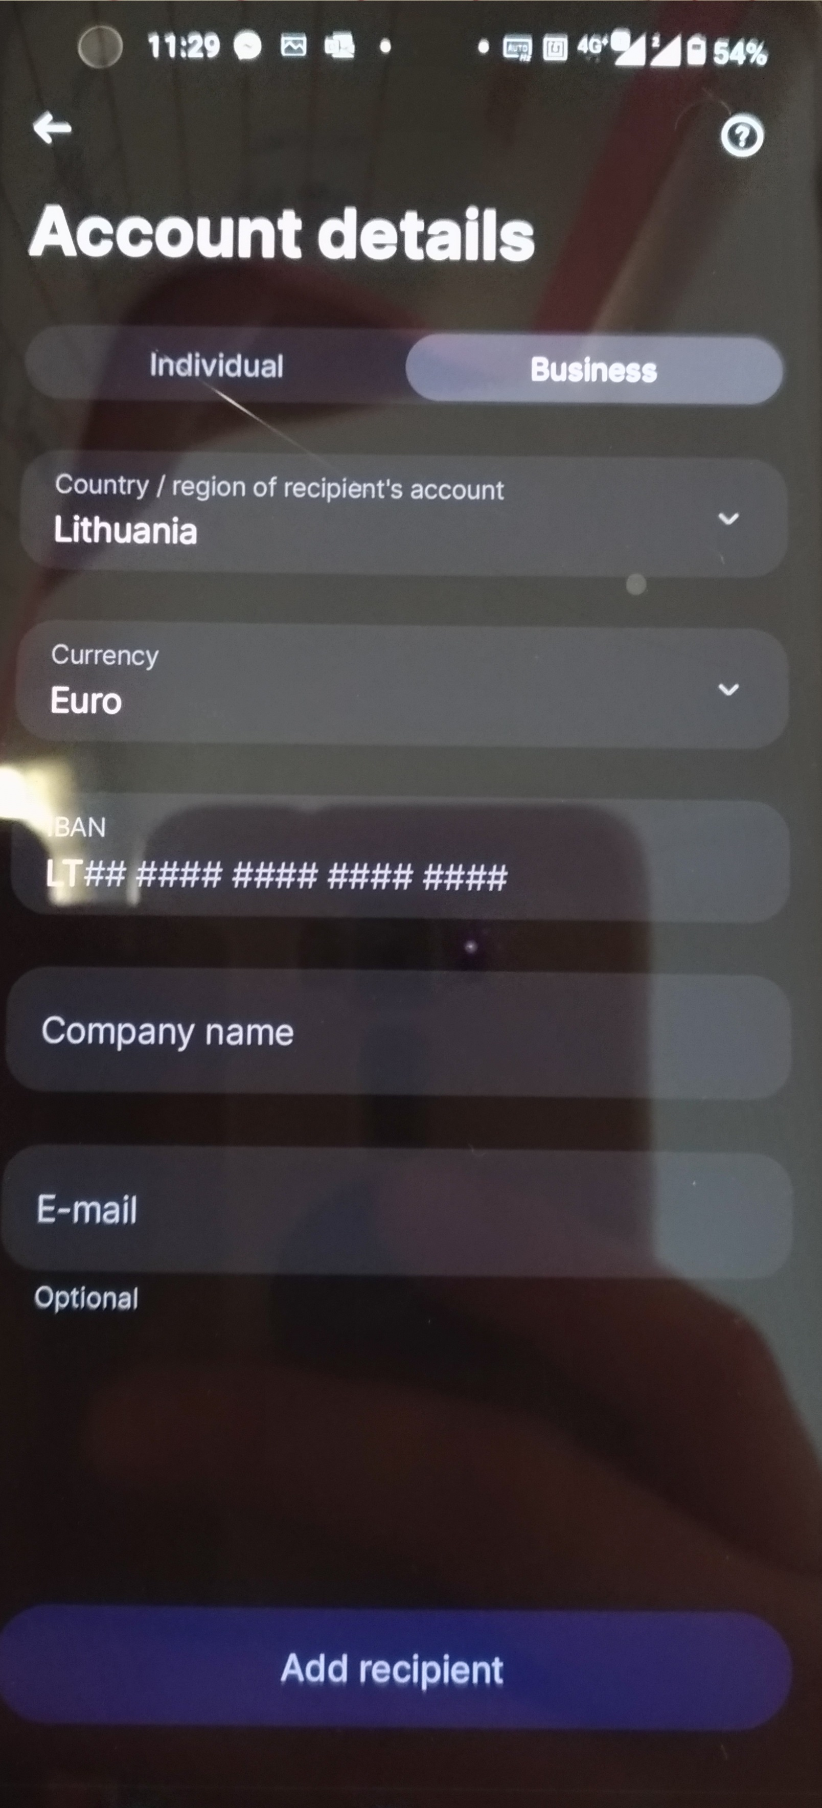
IN “Account details”
choose “Business”
MRU Student house Administration

Slide 10
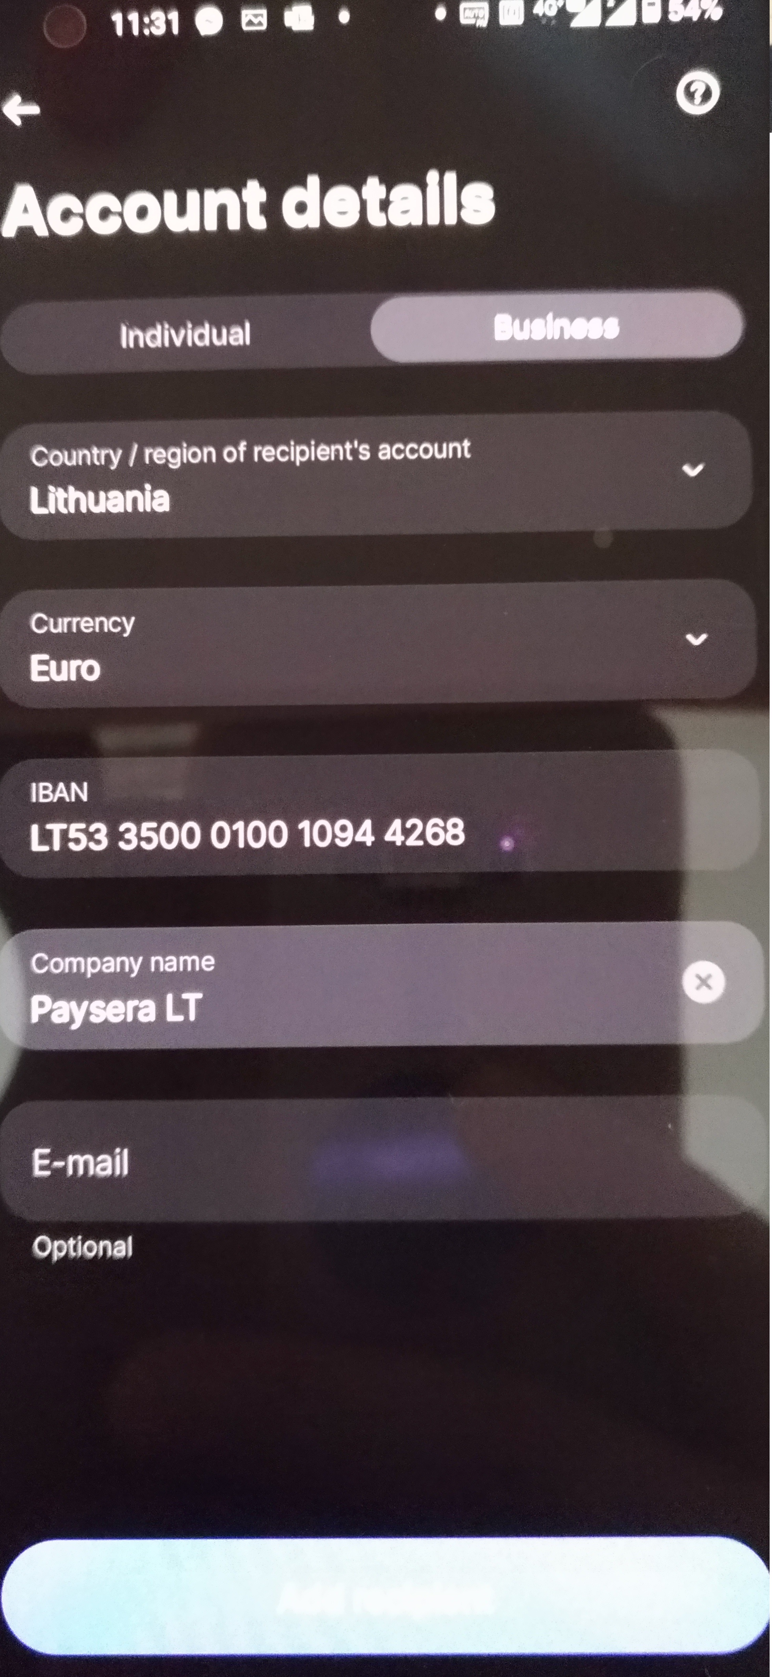
IN “Account details”
Now fill IBAN from payment page
MRU Student house Administration

Slide 11
IN “Account details”
Now fill “Company name” from payment page
MRU Student house Administration

Slide 12
IN “Account details”
CLICK on “Add recipient” button
MRU Student house Administration
Add recipient

Slide 13
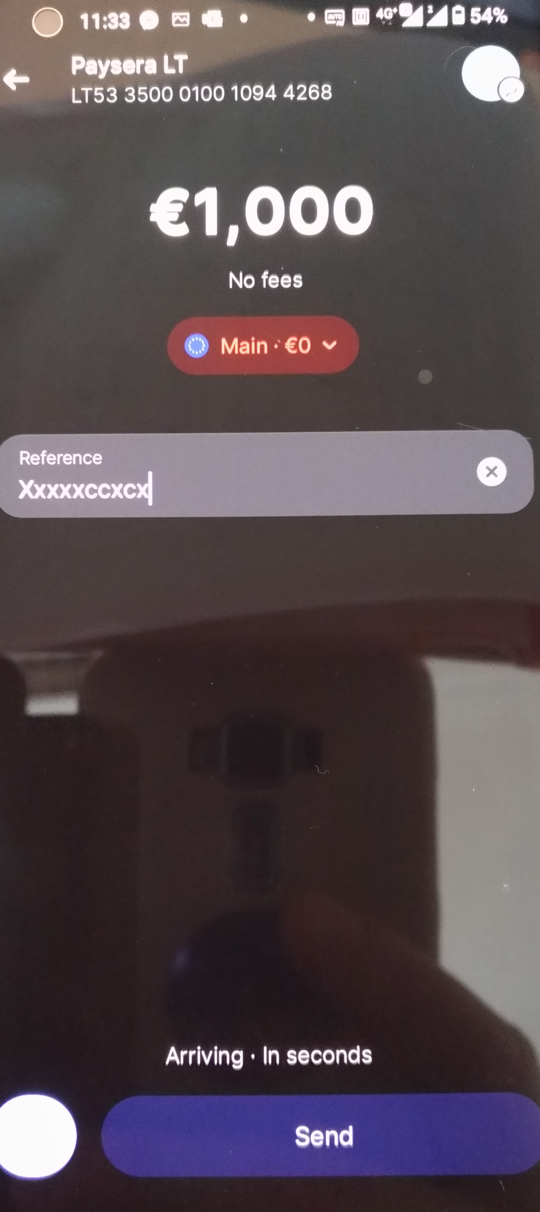
IN This new window you will need to add correct “Amount” form payment page
MRU Student house Administration
Add recipient

Slide 14
ADD correct “Purpose of payment”
IN YOUR PAYMENT YOU MUST DELETE: “Sent from Revolut”
Then enter your Purpose of payment instead
IMPORTANT: each payment has a different number, check here before making your payment.
MRU Student house Administration
Add recipient

Slide 15
CLICK SEND
DONE
MRU Student house Administration
Add recipient

Slide 16
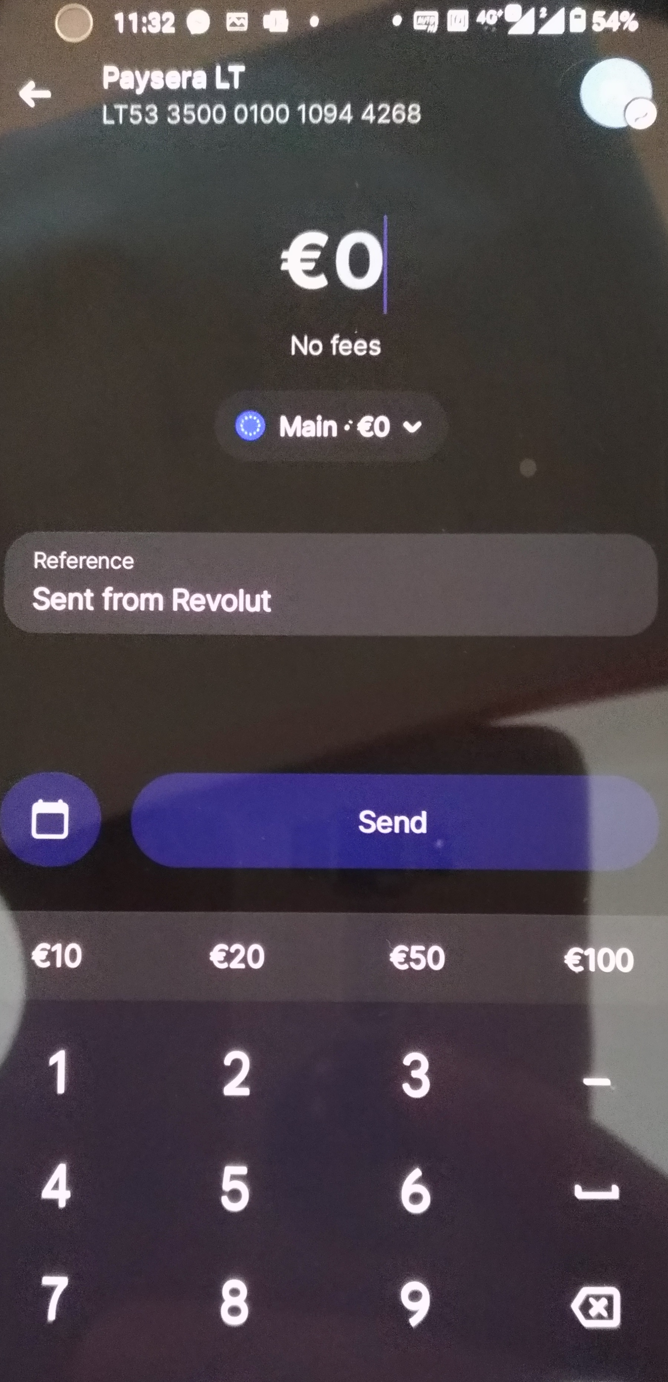
Next time you are paying
1. Open payment page, choose “Revolut”, it will make you new “Purpose of payment”
2. Open “Revolut” app
3. Select “Transfers”
4. Choose “Paysera”
5. Change amount to correct one form payment page
6. Delete “Sent form Revolut”
7. Input “Purpose of payment” from your new payment page and send, done.
MRU Student house Administration
Add recipient

Slide 17
Mykolas Romeris University
Ateities st. 20, Vilnius, LT-08303 Lithuania
www.mruni.eu

