Slide 1
Payment for Reservation or Accommodation using ANY BANK
MRU Student house Administration

Slide 2
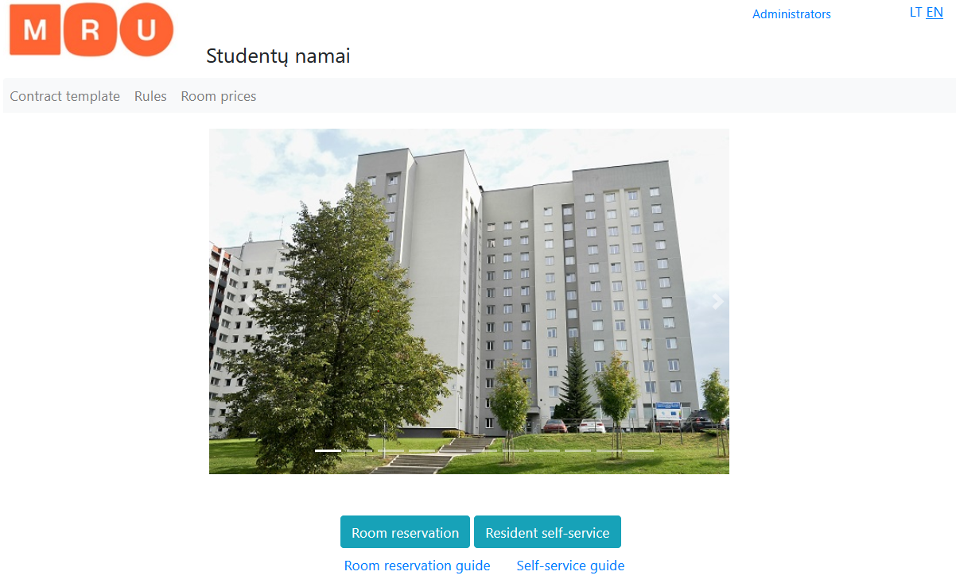
1. Choosing Reservation or Monthly payment
https://studentunamai.mruni.eu/
MRU Student house Administration

Slide 3
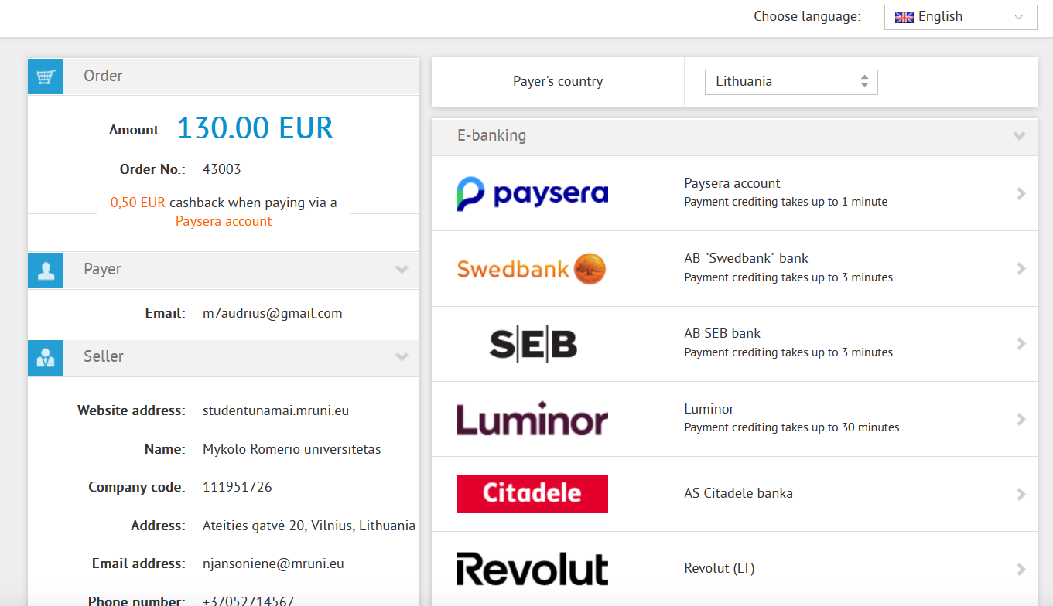
2. Payment part is the same for BOTH
Choose payers Country and Language
IF your country is NOT in the list OR your bank is not int the list – USE ENG Language and Payers country - Lithuania
THEN scroll to the bottom of the page.
Go to the next slide
MRU Student house Administration

Slide 4
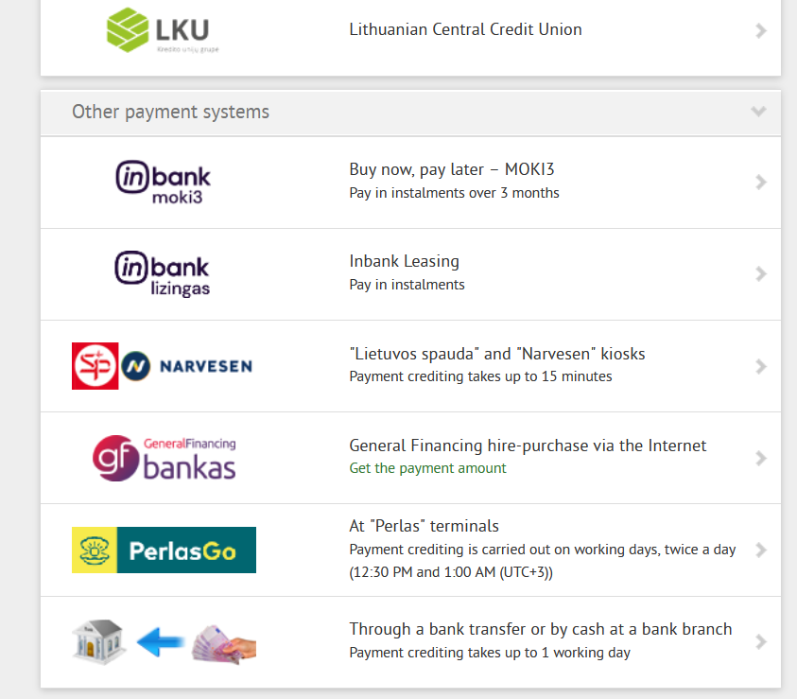
3. Choosing payment by bank
Between all available options choose:
“Through a bank transfer or by cash at a bank branch”
Go to the next slide
MRU Student house Administration

Slide 5
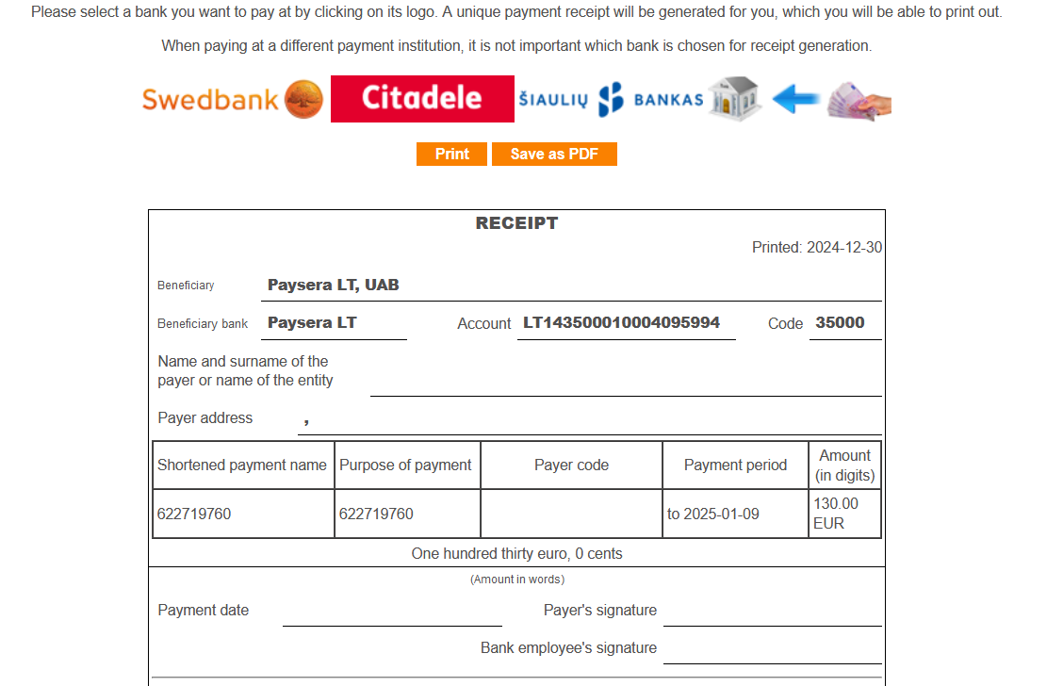
4. Receipt
System will make a receipt for your Bank or Online banking
BEFORE TRYING TO USE THE RECEIPT READ INFO
Receipt is one time use; each new payment must be made with new receipt. Payments made with old receipt will be lost and you will loose your money.
Receipt missing information– SWIFT code is: EVIULT2VXXX
Receipt valid until: “Payment period” DO NOT USE OLD RECEIPT
Between “Account”, “Benefactor” and “Purpose of payment “, they all are equally important and MUST NOT BE CHANGED. DO NOT ADD ANYTHING TO THE PURPOSE OF PAYMENT, or your payment will fail and you will lose your money.
IMPORTANT: “Purpose of payment “:
Your bank may call it different, for example: reference number, payment information etc.
This number will change with each payment; DO NOT USE OLD RECEIPT / OLD “Purpose of payment “
MRU Student house Administration

Slide 6
5. Q&A
Q: Is benefactor Mykolas Romeris University
A: NO – Benefactor is bank University is using: PAYSERA LT, UAB
Q: Can I just write it is for reservation?
A: NO – your payment goes to a Program, it does not understand your text, it will ONLY understand “Purpose of payment “
Q: My bank need more information about Paysera for transfer like address or legal entity number etc.
A: Here is official Paysera's website: https://www.paysera.lt/v2/en-LT/index
Q: What will happen if I make wrong payment?
A: You will lose your money OR 1. You will ask your bank to cancel your transaction; 2. Make new receipt; 3. Make new transaction.
Q: Should I save transaction document?
A: Yes, please save it until you confirmed it was received, in case of reservation until you got a confirmation email that your reservation is OK.
Q: I have more questions.
A: Contact us at studentunamai@mruni.eu
MRU Student house Administration

