Slide 1
REWIRE
Cybersecurity Skills Alliance a New Vision for Europe
Edmundas Piesarskas, EKT
BLUEPRINT
February 2, 2023

Slide 2


REWIRE cybersecurity skills blueprint
Support terrace
Industry and policy floor
- Job descriptions
Industry
room
Best practice / examples
ECSF (scope & taxonomy)
Skills development strategy
Policy
room
Skills need trends reports
Job analyzer
Education tracking
- Competence management
- Minimum skills
Educator
room
Support terrace
Seeker
room
- Advertising materials
- Curriculum designer
Best practice / examples
- Curriculum designer
- Training/CyberRange/scenario exchange
- Certification schemas
- Entry skills set
- Career path for
up / re -skilling
Skills seekers and developers floor

Slide 3


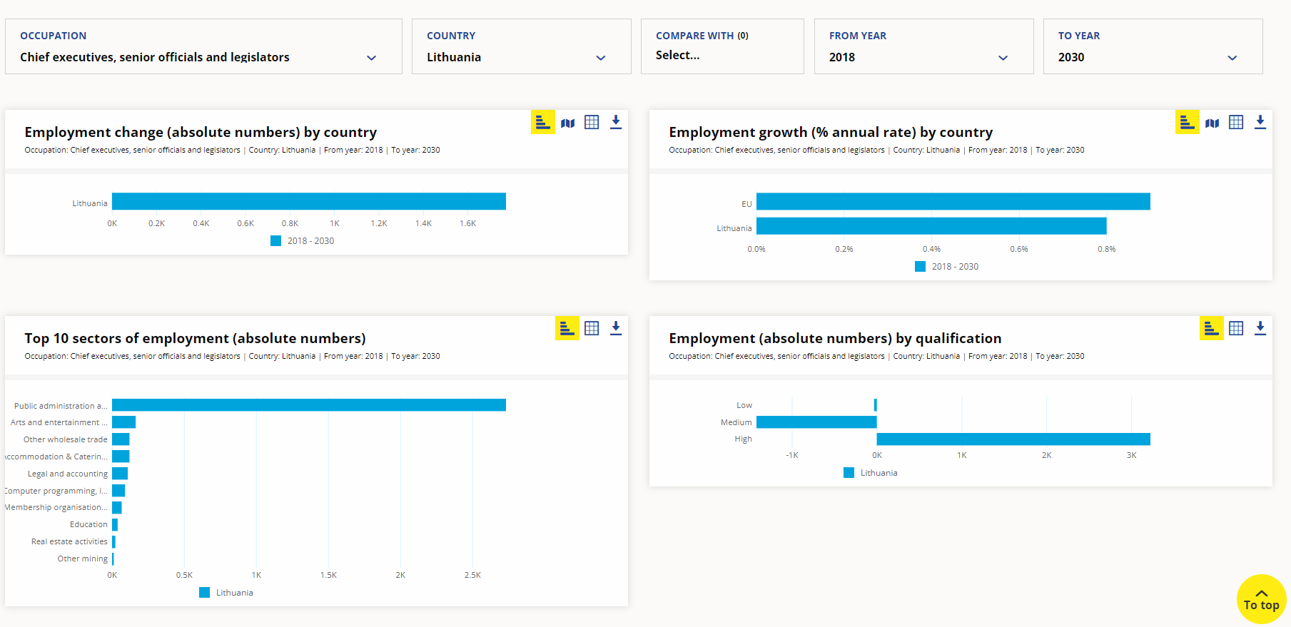
Skills intelligence
“Skills intelligence is the outcome of an expert-driven process of identifying, analysing, synthesising and presenting quantitative and/or qualitative skills and labour market information.
To remain relevant, skills intelligence must be kept up-to-date and adjusted when user needs change. This requires the expert-driven process to be continuous and iterative.”
Source: CEDEFOP, Crafting skills intelligence | CEDEFOP (europa.eu)

Slide 4
Skills intelligence
The REWIRE project has created a plan to identify, analyze, synthesize and present cybersecurity skills information
as conceived at the beginning of the project, (then)
as evolved during the lifetime of the project (now) and
as envisioned to become in the future (tomorrow).

Slide 5
Cybersecurity skills (Then) (1)
The project researched, identified and analyzed already established cybersecurity skills frameworks from various sources (national, international, public, private).
The results of this analysis are included in
Deliverable R2.2.2. Cybersecurity Skills Needs Analysis and
the 1st iteration of the R5.4.1 Policy Recommendations.

Slide 6
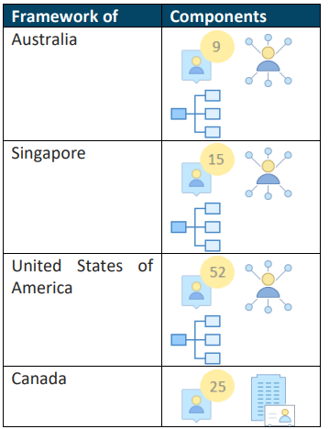
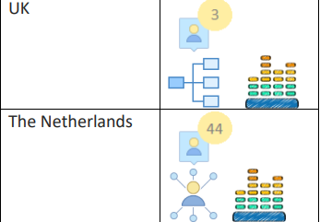





Cybersecurity skills (Then) (2)
Key aspects:
a lack of skilled and qualified personnel.
multitude of fields (following the diversity of cybersecurity as a topic) and are technical and organizational in nature
Source: R5.4.1 Policy Recommendations
Role Profiles
Career paths
Structure
SME focus
Levels

Slide 7
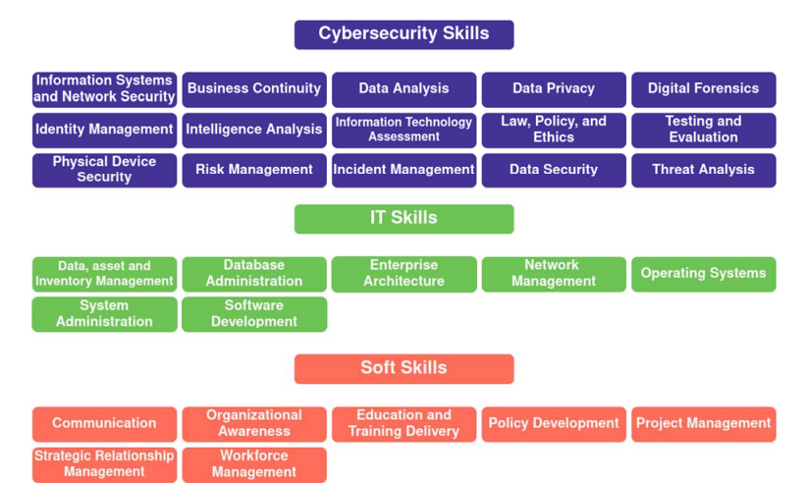
Cybersecurity skills (Then) (3)
In R2.2.2. Cybersecurity Skills Needs Analysis the proposed by the REWIRE project Cybersecurity Skills categories are introduced following the relevant stakeholder, pilot project and cybersecurity skills framework analysis.

Slide 8
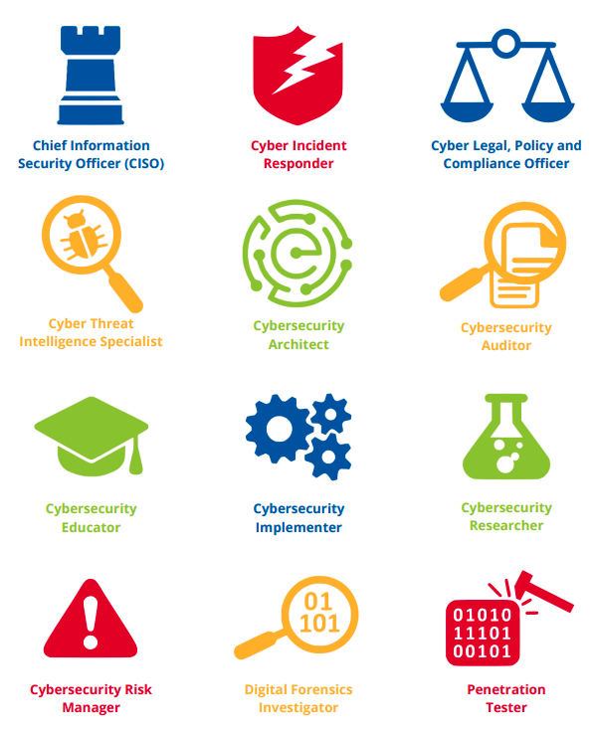
Cybersecurity skills (Now)
In May 2022 the REWIRE project completed an extensive analysis of the 0.5 version of the European Cybersecurity Skills Framework.
The results of this analysis as well as the project’s recommendations are included in deliverable R3.3.1 Cybersecurity skills Framework.

Slide 9
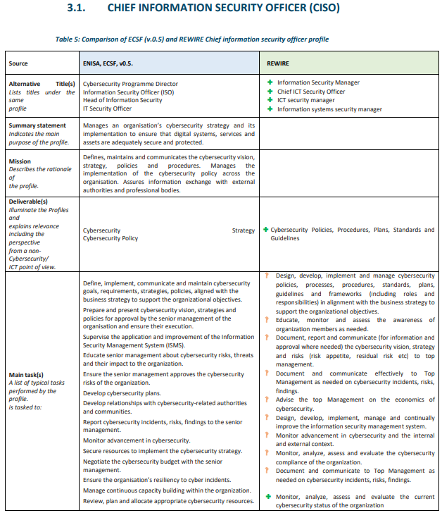

Cybersecurity skills (Now) (2)
Sumbols used to denote changes proposed by REWIRE:
Addition to ECSF v0.5
Adaptation or change
Removal
The REWIRE project is currently completing also the analysis of V1.0 of the ECSF (published in September 2022).

Slide 10
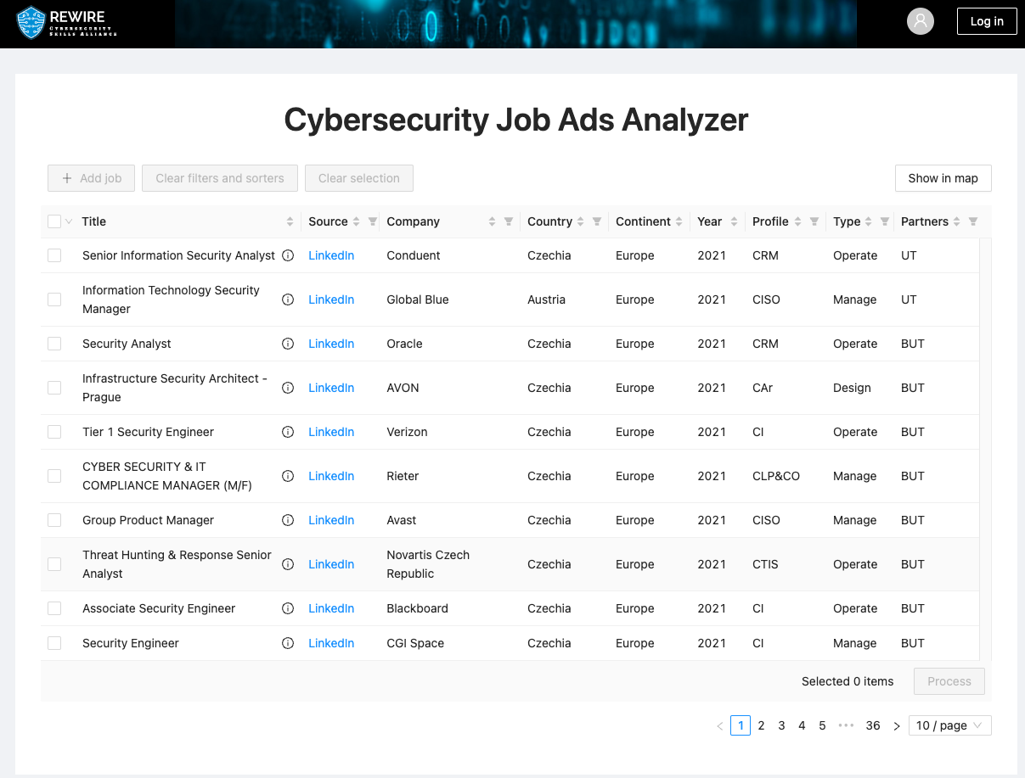
Cybersecurity skills (Tomorrow)
In R.2.2.3. Methodology to anticipate future needs the project proposed a methodology to facilitate the identification of future needs based also on inputs from specific stakeholders and the market.
The REWIRE project has already created a tool Cybersecurity Job Ads Analyzer. This tool helps in the processing of information form Job ads and the extraction of information on current and emerging skills needs. Currently 300+ ads have been analyzed. More being processed.

Slide 11
Cybersecurity skills strategy
“Sector Skills Strategies are “road maps” developed by business, labour, education providers, government departments, development agencies and community organisations within a single industry or economic sector to improve workforce skills, nurture talent pipe-lines, foster competitiveness, grow businesses and expand.”
The first step undertaken by the REWIRE project in the process of creating the strategy was a PESTLE analysis.
Source: https://frresearch.co.za/creating-sector-skills-strategies-that-work/

Slide 12
PESTLE Analysis on Cybersecurity Education / Gaps
Political
Environmental
Economic
Social
Techno
logical
Legal
31 Aspects
5
7
6
5
5
3
4 Gap drivers
3 Strategic Needs
STRATEGIC PRIORITIES
STRATEGIC OBJECTIVES
Strategy
18 Supporting Actions
Notes:
The next slides provide details on the Gap drivers, the strategic needs, the strategic priorities and objectives and the supporting actions

Slide 13
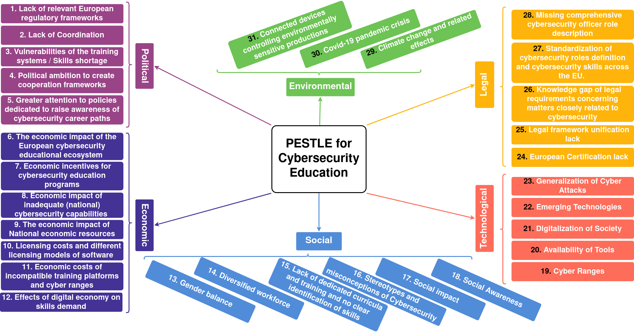
WHAT IS IT?
PESTLE analysis allows for identifying skills shortages, gaps, and mismatches, namely aspects, affecting cybersecurity education from different angles.
WHY:
A skill strategy can be developed from these aspects classification.

Slide 14
The strategic needs
a) Need to increase the supply for cybersecurity skills development
b) Need to transform the demand for cybersecurity skills
c) Need to transform the inventory of cybersecurity skills development
Supply
Demand
Simplification

Slide 15
strategic need a
STRATEGIC NEEDS
Need to increase the supply for cybersecurity skills development
STRATEGIC PRIORITIES
Transforming and repositioning (rebranding) cybersecurity
STRATEGIC OBJECTIVES
Increase the number of candidates for cybersecurity training

Slide 16
strategic need B
STRATEGIC NEEDS
Need to transform the demand foy cybersecurity skills
STRATEGIC PRIORITIES
Fostering integration of cybersecurity with business agenda
STRATEGIC OBJECTIVES
Defining cybersecurity as a significant function of an organization
Enhance understanding of cybersecurity threats
Strengthen cooperation between training organizations and industry

Slide 17
strategic need C
STRATEGIC NEEDS
Need to transform the inventory of cybersecurity skills development
STRATEGIC PRIORITIES
Transforming cybersecurity skills development to make them better structured and more simplified
STRATEGIC PRIORITIES
STRATEGIC OBJECTIVES
Support the development of training measures
Establish common cybersecurity training standards
Model effective cybersecurity training
STRATEGIC OBJECTIVES

Slide 18
1. INCREASE THE NUMBER OF CANDIDATES FOR CYBERSECURITY TRAINING
4. STRENGTHEN COOPERATION BETWEEN INDUSTRY AND TRAINING ORGANIZATIONS
1.1. Rebrand cybersecurity
1.2. Promote cybersecurity as a career choice
1.3. Promote cybersecurity in higher education
4.1. Engage different stakeholders in identification of different cybersecurity skills
4.2. Engage industry in validation of different skills
4.3. Engage industry in delivering training in cooperation with HEIs
4.4. Support cooperation between training organizations and industry
STRATEGIC OBJECTIVES & SUPPORTING ACTIONS
2. ENHANCING UNDERSTANDING OF CYBERSECURITY THREATS
5. SUPPORT THE DEVELOPMENT OF TRAINING MEASURES
2.1. Provide regular analysis on cybersecurity threats
5.1. Facilitate creation of standardized and exchangeable training scenarios
5.2. Support the development of training platforms
5.3. Support the continuous professional development of trainers
3. DEFINE CYBERSECURITY AS A SIGNIFICANT FUNCTION OF AN ORGANIZATION
3.1. Making it easier to access, understand and use cybersecurity tooling
3.2. Fostering cybersecurity aspect inclusion in business models, planning, assessment and other instruments
6. ESTABLISH COMMON CYBERSECURITY TRAINING STANDARDS
7. MODEL EFFECTIVE CYBERSECURITY TRAINING
6.1. Design of a European skills framework for cybersecurity
6.2. Develop cybersecurity skills and degrees certification scheme
7.1. Improve re-skilling and up-skilling for cybersecurity
7.2. Increase accessibility of cybersecurity training
7.3. Continuous training of specific target groups

Slide 19
REWIRE cybersecurity skills blueprint
Support terrace
Industry and policy floor
- Job descriptions
Industry
room
Best practice / examples
ECSF (scope & taxonomy)
Skills development strategy
Policy
room
Skills need trends reports
Job analyzer
Education tracking
- Competence management
- Minimum skills
Educator
room
Support terrace
Seeker
room
- Advertising materials
- Curriculum designer
Best practice / examples
- Curriculum designer
- Training/CyberRange/scenario exchange
- Certification schemas
- Entry skills set
- Career path for
up / re -skilling
The CyberABILITY
platform
Skills seekers and developers floor

Slide 20
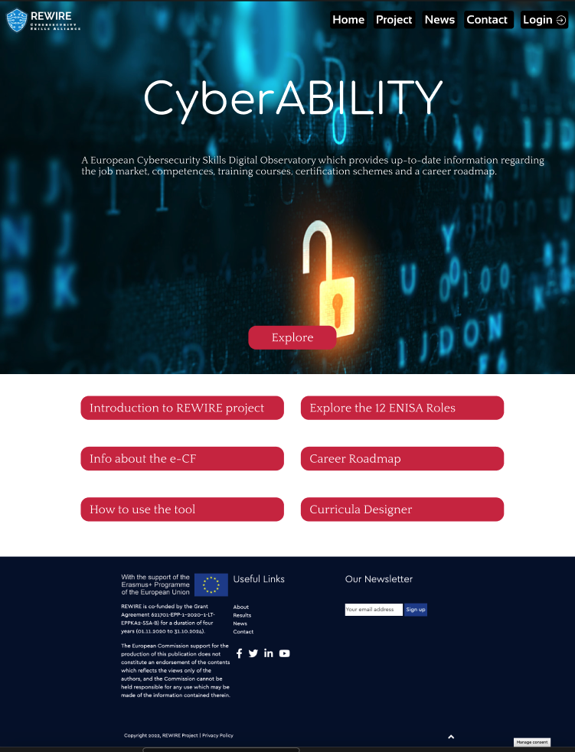
7.2. Increase accessibility of cybersecurity training
Publicly available tool that will try to address lack of existing information on cybersecurity skills, trainings and certifications
The tool will incorporate the information from the career map and the training and certification interconnection tool to provide information to all interested parties
The CyberABILITY platform

Slide 21
Thank you
More information:
www.rewireproject.eu/
https://www.linkedin.com/company/rewireprojecteu/
Speaker/Presenter (Full Name): Edmundas Piesarskas
Role in the Organisation: active in all WP’s
Organisation, Country: UAB Ekonominės konsultacijos ir tyrimai (EKT)
E-mail address: edmundas@ekt.lt

